Slide 1

Machine Learning Final Project PTB Diagnostic ECG Database
Ali babaloo
Pouya sharifi
Amirkabir University of Technology
winter 2023

Slide 2
Outline
ECG
PTB Diagnostic ECG Database
Advantages of Using Transfer Learning
ResNet50
EfficientNet B7
Custom VGG

Slide 3
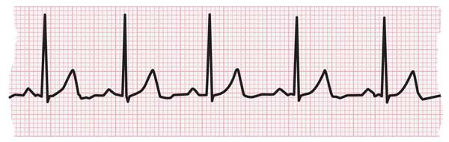
ECG
An electrocardiogram (ECG or EKG) records the electrical signal from the heart to check for different heart conditions. Electrodes are placed on the chest to record the heart's electrical signals, which cause the heart to beat. The signals are shown as waves on an attached computer monitor or printer.
Why it’s done?
irregular heart rhythms (arrhythmias)
If blocked or narrowed arteries in the heart (coronary artery disease) are causing chest pain or a heart attack
Whether you have had a previous heart attack
How well certain heart disease treatments, such as a pacemaker, are working

Slide 4
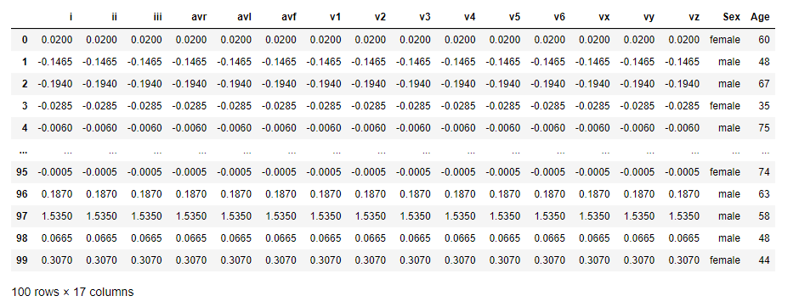
PTB Diagnostic ECG Database
The ECGs in this collection were obtained using a non-commercial, PTB prototype recorder with the following specifications:
16 input channels, (14 for ECGs, 1 for respiration, 1 for line voltage)
Input voltage: ±16 mV, compensated offset voltage up to ± 300 mV
Input resistance: 100 Ω (DC)
Resolution: 16 bit with 0.5 μV/LSB (2000 A/D units per mV)
Bandwidth: 0 - 1 kHz (synchronous sampling of all channels)
Noise voltage: max. 10 μV (pp), respectively 3 μV (RMS) with input short circuit
Online recording of skin resistance
Noise level recording during signal collection

Slide 5
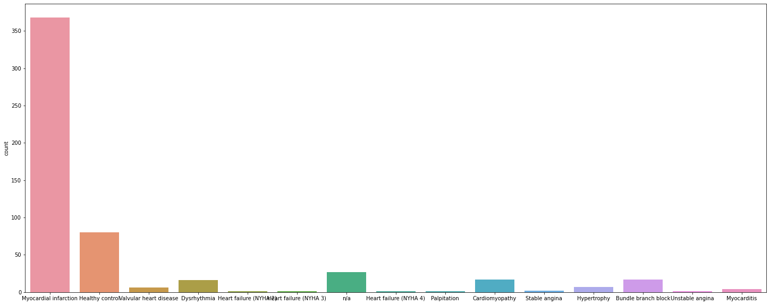
15 output classes but we trained with “Myocardial infraction” vs others

Slide 6
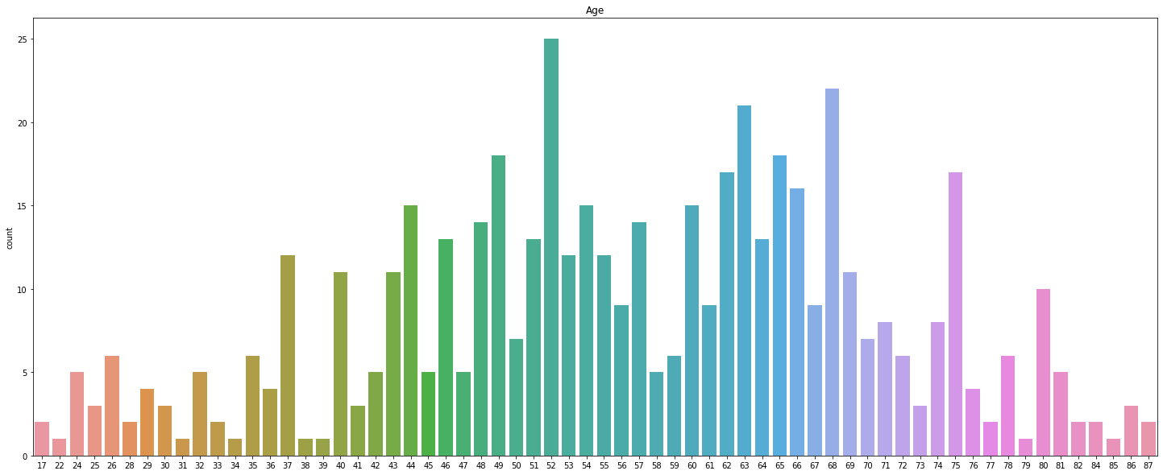
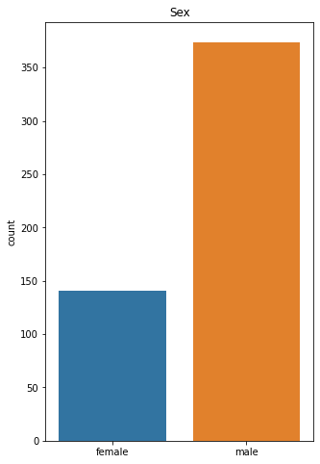
Age and Sex distribution

Slide 7
Advantages of Using Transfer Learning
Transfer learning is an effective way to utilize the knowledge of pre-trained models and leverage it to train new models quickly and accurately.
It can provide significant improvements to accuracy and speed up training time compared to training a model from scratch.

Slide 8
What is ResNet?
ResNet, short for Residual Network is a specific type of neural network that was introduced in 2015 by Kaiming He, Xiangyu Zhang, Shaoqing Ren and Jian Sun in their paper “Deep Residual Learning for Image Recognition ”. The ResNet models were extremely successful which you can guess from the following:
Won 1st place in the ILSVRC 2015 classification competition with a top-5 error rate of 3.57% (An ensemble model)
Won the 1st place in ILSVRC and COCO 2015 competition in ImageNet Detection, ImageNet localization, Coco detection and Coco segmentation.
Replacing VGG-16 layers in Faster R-CNN with ResNet-101. They observed relative improvements of 28%

Slide 9
Need for ResNet
Mostly in order to solve a complex problem. The intuition behind adding more layers is that these layers progressively learn more complex features. For example, in case of recognizing images, the first layer may learn to detect edges, the second layer may learn to identify textures and similarly the third layer can learn to detect objects and so on. But it has been found that there is a maximum threshold for depth with the traditional Convolutional neural network model.
We can see that error% for 56-layer is more than a 20-layer network in both cases of training data as well as testing data. This suggests that with adding more layers on top of a network, its performance degrades. This could be blamed on the optimization function, initialization of the network and more importantly vanishing gradient problem. You might be thinking that it could be a result of overfitting too, but here the error% of the 56-layer network is worst on both training as well as testing data which does not happen when the model is overfitting.
We have to solve the vanishing gradient problem

Slide 10
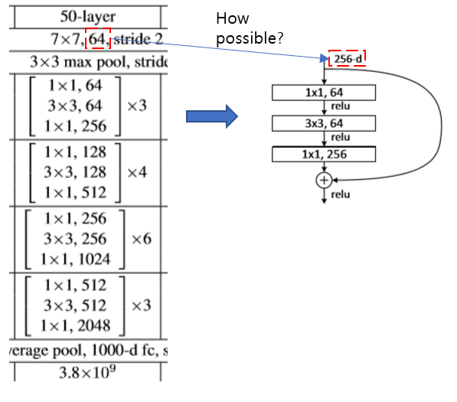
Architecture of ResNet Deep Learning Model
To solve vanishing gradient, ResNet has an architecture that uses skip connections to enable the network to train deeper and faster.
It consists of a series of building blocks, each containing multiple layers and a shortcut connection to the layer preceding it.
The skip connections in ResNet solve the problem of vanishing gradient in deep neural networks by allowing this alternate shortcut path for the gradient to flow through

Slide 11
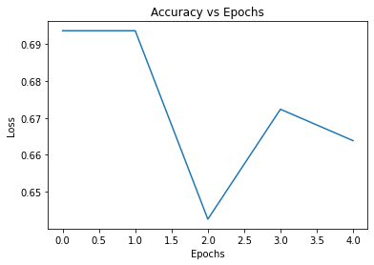
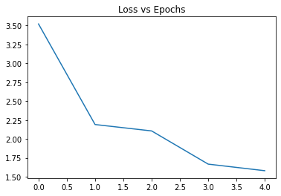
Results

Slide 12
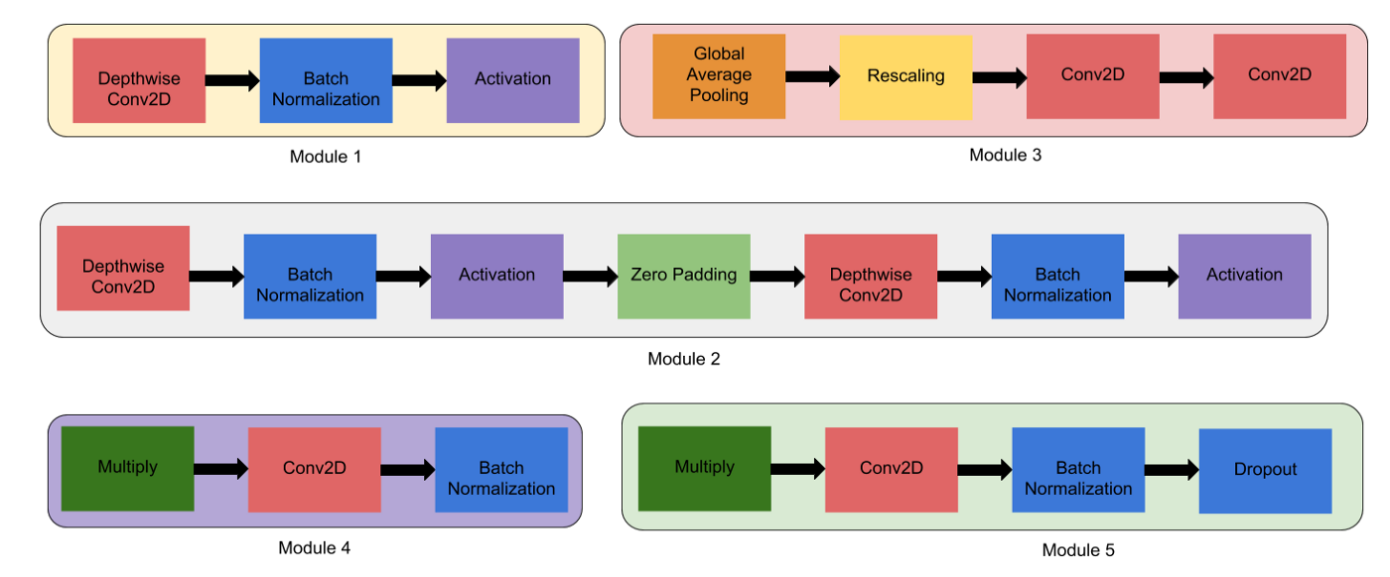
EfficientNet B7
Module 1 — This is used as a starting point for the sub-blocks.
Module 2 — This is used as a starting point for the first sub-block of all the 7 main blocks except the 1st one.
Module 3 — This is connected as a skip connection to all the sub-blocks.
Module 4 — This is used for combining the skip connection in the first sub-blocks.
Module 5 — Each sub-block is connected to its previous sub-block in a skip connection and they are combined using this module.

Slide 13
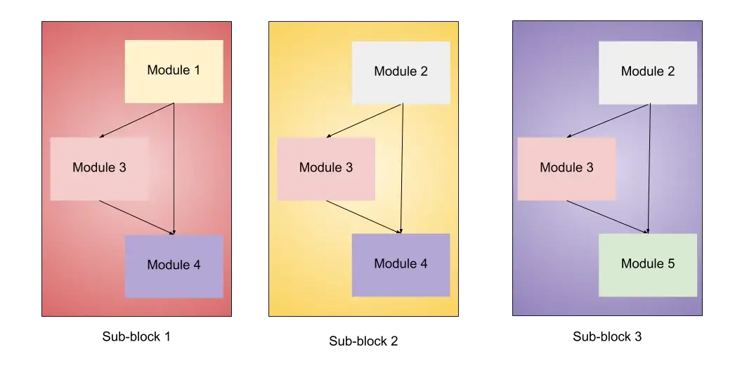
Sub-block 1 — This is used only used as the first sub-block in the first block.
Sub-block 2 — This is used as the first sub-block in all the other blocks.
Sub-block 3 — This is used for any sub-block except the first one in all the blocks.

Slide 14
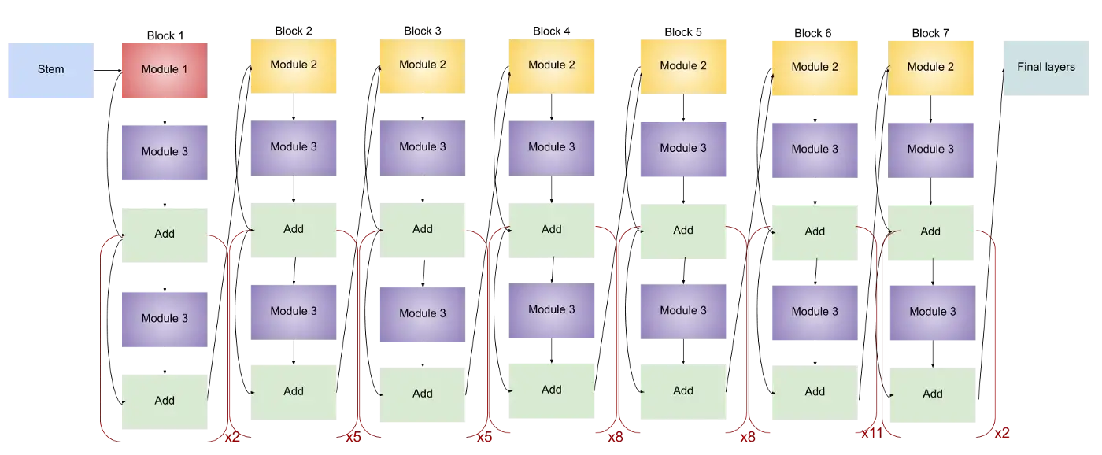
EfficientNet B7 Architecture

Slide 15
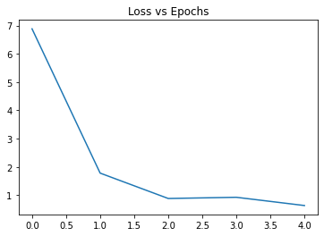
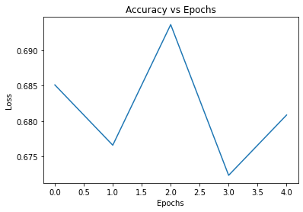
Results

Slide 16
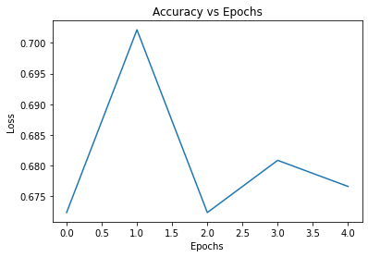
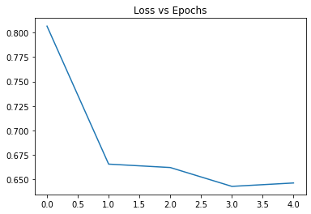
Custom VGG results:

